Slide 1

www.innovating4earth.eu
WORKSHEETS
MODULE 2

Slide 2
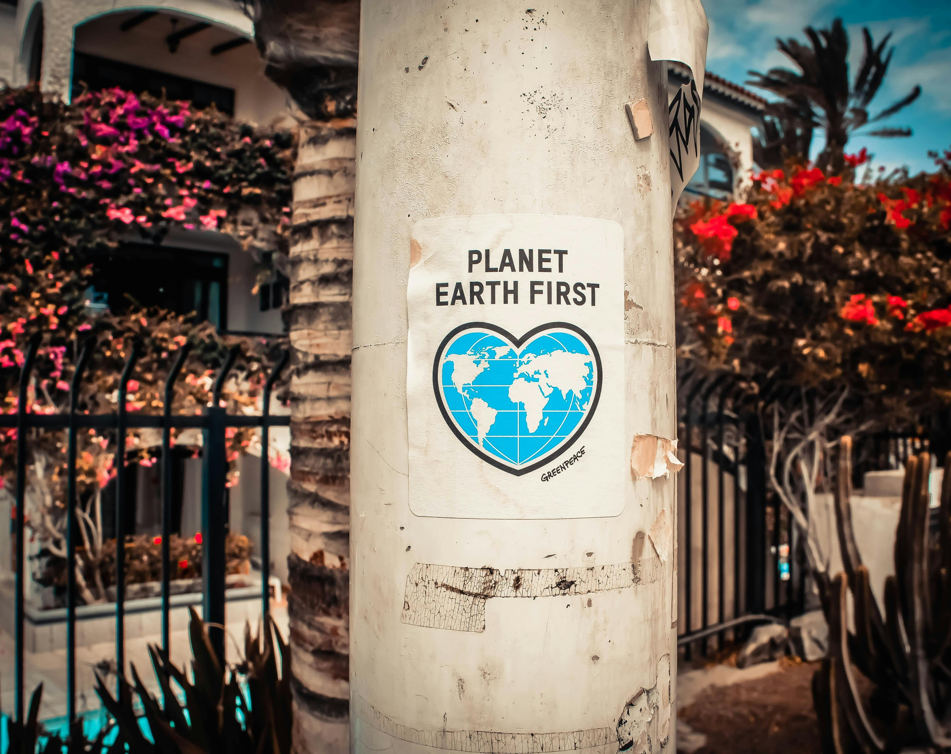
WEEK 4

Slide 3
DIGITALISATION IN INNOVATION MANAGEMENT
Step 1: Identifying a Company’s Problems & Innovations
Before selecting digital tools, it is essential to understand a company’s challenges and innovation needs. Choose any company to analyse – for inspiration and diverse examples from different countries and industries, check the EARTH Good Practice Compendium.
How to Identify Problems & Innovation Needs
Use the following checklist to analyse the company’s situation:
Example: One logistics company struggles with delivery delays and is exploring AI-driven route optimisation. Meanwhile, another logistics provider is dealing with warehouse congestion and is considering an automated inventory management system to improve storage efficiency and order fulfilment.
Aspect | Guiding Questions | Your Chosen Company
Target & Purpose | What is the company’s mission and main objectives? What are its key products/services?
Challenges | What are the company’s biggest operational or strategic challenges? (E.g., efficiency, customer engagement, sustainability, cost reduction) What are specific regional challenges your company faces?
Existing Innovations | Has the company introduced any innovative solutions? How successful have they been?
Innovation Manage-ment Stages | Which stage is the company in? (e.g., idea generation, development, implementation, etc.)
Industry Trends | What external trends are affecting innovation in this industry?

Slide 4
DIGITALISATION IN INNOVATION MANAGEMENT
Step 2: Identifying and Selecting Relevant Digital Tools
Once the company's needs are understood, explore digital tools that can support the innovation management process, such as tools for idea generation, development, or implementation.
Resources for Finding Digital Tools:
To support the innovation process – from idea generation to implementation – consider tools that help manage, structure, and accelerate innovation activities. These can include:
Analytics and foresight tools (e.g. Statista, Power BI, Crunchbase): Identify trends, assess market potential, and support evidence-based decisions.
Idea management platforms (e.g. Brightidea, Qmarkets): Collect, evaluate, and prioritise innovation ideas.
Collaboration tools (e.g. Miro, Lucidspark, Microsoft Teams): Support brainstorming, visualisation, and cross-team ideation.
Prototyping and testing tools (e.g. Figma, MarvelApp): Create and test early-stage concepts.
Project and innovation pipeline management systems (e.g. Planbox, ClickUp, InnovationCloud): Track innovation stages and support execution.
You can find digital tools through, not exclusively, the following resources:
Market Research & Industry Reports – Look at commonly used innovation tools within similar industries.
EARTH Starter Kit – See a curated list of digital tools aligned with the stages of the innovation process (pp. 23–29), with a focus on logistics.
Checklist for Evaluating Digital Tools:
Functionality: Does it support a specific stage of innovation (e.g. idea generation, development, testing)?
Ease of Implementation: Can it be integrated smoothly into current systems and workflows?
Cost & ROI: Is it cost-effective, and does the benefit justify the investment?
Scalability: Can the tool adapt and grow with future innovation needs?
User-Friendliness: Will employees find it intuitive and easy to use?
Final Selection:
After evaluating different options, select the tool that best aligns with the company’s challenges and innovation goals (from Step 1).
Example: A logistics company selects Miro, a collaborative online whiteboard, because it enhances brainstorming and workflow visualisation, supporting the ideation stage (Stage 2: Ideation and Idea Management) of innovation management and improving team coordination.

Slide 5
WEEK 5

Slide 6
SUSTAINABILITY IN DIGITAL INNOVATION MANAGEMENT
BEFORE CLASS
Get familiar with the concept of Sustainable Development Goals (SDGs). You can explore it on the United Nations website here. Additionally, refer to the SDGs and their connection to logistics in the EARTH Starter Kit (pp. 8-13).​
​
DURING CLASS
In this activity, you will form groups and analyse a real-world sustainability challenge in logistics, identifying potential solutions and how to manage them within the stages of the innovation management process. Your task is to apply insights from the EARTH Good Practice Compendium to connect sustainability and innovation management.
Objectives:
Understand key sustainability challenges in logistics.
Apply innovation management stages to the identified solutions.
Step 1: Identify a Sustainability Challenge
Choose a case study from the EARTH Good Practice Compendium (pp. 7-69) and summarise:
The sustainability challenge.
The current solution implemented by the company.
The company may face numerous sustainability challenges and implement solutions. Identify all of them. It may be that the case presents the challenge but not the solution, or presents the solution but not the challenge being addressed. In these cases, think of the missing aspect and suggest what could be the corresponding challenge or solution.
Example:
GLS Italia Spa – Digital Platforms and Clean Vehicles for Sustainable Delivery (EARTH Good Practice Compendium, pp. 12-14)
GLS Italia Spa, a major logistics provider in Italy, aims to reduce carbon emissions while maintaining reliable delivery services. Their approach includes:
Investing in electric vehicles and charging infrastructure.
Installing photovoltaic systems at depots to power operations.
Using digital platforms (e.g., ServiceNow) to coordinate sustainability initiatives.
Complete the following table for this activity. The first line presents the GLS Italia Spa example.
Case Study | Sustainability Challenge | Solution Implemented
GLS Italia Spa | High CO₂ emissions in urban delivery | Electric vehicles, solar power, digital platform for coordination

Slide 7
SUSTAINABILITY IN DIGITAL INNOVATION MANAGEMENT
Step 2: Apply the Innovation Management Stages
Now, evaluate the implemented solution and break it down into the stages of innovation management. Your task is to complete the table for the case study you chose in Step 1. If the information is not available on the case materials in the EARTH Good Practices Compendium, brainstorm what could have been done by the company at the various stages.
Stage | GLS Italia Spa Case Study | (Your Case)
Opportunity Identification | Recognised the need to reduce CO₂ emissions from parcel delivery and facility energy use in line with national sustainability goals and customer expectations.
Idea Generation | Explored the use of electric vehicles, renewable energy (solar power), and digital tools to coordinate environmental initiatives.
Concept Development | Partnered with Volvo and other suppliers to develop e-vehicle solutions; mapped out photovoltaic system installations across depots.
Service/ Product/Process Development | Installed photovoltaic systems and charging infrastructure; began deployment of electric vans in selected regions.
Testing & Validating | Monitored performance of electric vehicles and energy systems in pilot locations to assess emissions reduction and service reliability.
Commerciali-sation | Scaled up the use of green methanol-fuelled ships across global shipping operations and expanded blockchain adoption.

Slide 8
SUSTAINABILITY IN DIGITAL INNOVATION MANAGEMENT
Step 3: Propose Additional Innovations
Suggest two innovative ideas that can be managed through the innovation stages, that the company could implement to further align with the SDGs and improve its sustainability efforts in logistics. The ideas can be related to the sustainability challenge identified in Step 1 or not. Be creative!
Example GLS Italia Spa:
AI-based delivery route optimisation to improve energy efficiency and reduce emissions.
Development of urban micro-hubs powered by renewable energy to enable low-emission last-mile delivery.
List your two additional innovation ideas here:
1.____________________________________________________________________________________________________________________________________________________________________________________________________________________________________________________________________
2._____________________________________________________________________________________________________________________________________________________________________________
_______________________________________________________________________________________
Step 4: Discuss Key Takeaways
Discuss your findings in class with your teacher and other groups. Be prepared to share the following (take some notes, if necessary):
What sustainability challenge did the company address, and how does it connect to the SDGs?
How might the company have structured its innovation management process to develop and implement a solution?
What digital tools for the innovation management process supported or could support this innovation?
What additional sustainable logistics solutions could improve the company’s approach?

Slide 9
WEEK 6

Slide 10
DIGITAL TOOLS FOR INNOVATION MANAGEMENT
In this activity, you will work in groups to:
Select digital tools that support sustainable innovation management in logistics.
Focus on one innovation management stage and analyse relevant tools.
Create an infographic showcasing how these tools support sustainability.
Analyse and compare tools based on pricing, functionality, and usability.
Step 1: Select a Digital Tool
Select an innovation management stage from the Digital Innovation Whitepaper (pp. 7-8), keeping in mind not only the overall process level (1st level) but also the more detailed procedures (2nd level) and specific tasks within the steps (3rd level).
Choose at least two tools relevant to your selected innovation management stage from the list of tools provided in the EARTH Starter Kit (pp. 23-29).
Identify how these tools assist companies in addressing sustainable logistics challenges (e.g., examining tools websites, online articles, etc.).
Example: Stage 3 – Concept Development
Tool 1: Miro (for brainstorming concepts for sustainable solutions)
Tool 2: Trello (for managing concept development tasks)
Step 2: Compare the Tools
Evaluate your selected tools based on the following table:
Selected Innovation Management Stage:
Criteria | (Tool 1) | (Tool 2) | (Tool 3)
Stage Tasks Which specific tasks (3rd level) within the selected stage does it help with?
Main Function What does the tool do? Which functions can be used in the selected stage?
Pricing Free or Paid? What are the differences between free to paid versions?
User-Friendliness Easy to use? Does it take long to learn how to use it?
Best for Which types of companies/ teams benefit the most?
Sustainability & Innovation Support Does it have specific features for sustainability and innovation management?

Slide 11
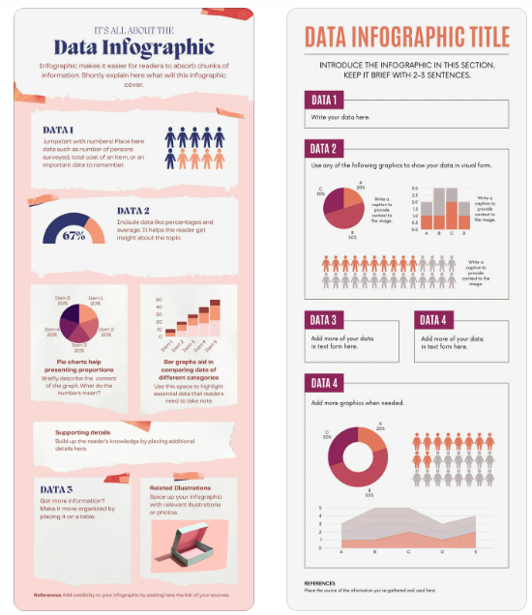
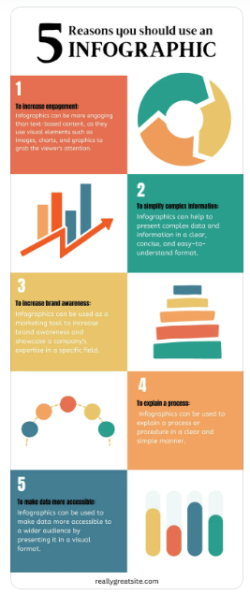
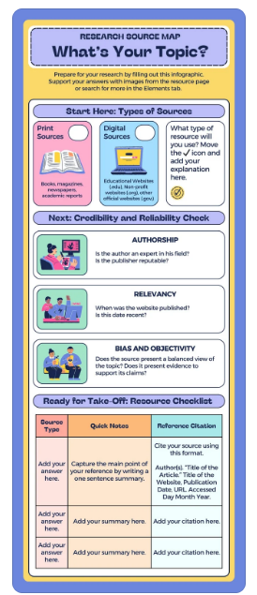
DIGITAL TOOLS FOR INNOVATION MANAGEMENT
Step 3: Create an Infographic
Use online tools to create your infographic, such as:
Canva – User-friendly, free templates.
Piktochart – Useful for visual comparisons.
PowerPoint – Customisable design with SmartArt function (on menu “Insert”).
Your infographic should include:
Title: The selected innovation stage and tools.
Key Features: Briefly describe how each tool functions.
Comparison Table: Highlight strengths and weaknesses based on the criteria evaluated in Step 2.
Visuals/Screenshots: Show examples of how these tools look when used with screenshots.
Reflection: How do these tools help companies implement/manage sustainable logistics solutions?
Here is how an infographic could look:
Step 4: Present Your Findings
Your group will:
Briefly present the infographic created (3-5 minutes).
Explain how the tools support innovation management.
Discuss your reflection on the tools' usability and impact, especially for sustainable logistics implementation.
Be prepared to discuss the following:
Which tool was more effective for your assigned innovation stage? Why?
Did you find limitations in the tools when addressing sustainability challenges?
How could companies better integrate these tools into their processes?
Step 5: Evaluation Questionnaire
After completing the module, you will reply to a short quantitative evaluation questionnaire to assess what you have learned about innovation management digitalisation and sustainability.
Access the online form (link provided by your teacher).
Answer the questionnaire.
Submit your answers before the deadline defined by your teacher.

