Slide 1

www.innovating4earth.eu
WORKSHEETS
MODULE 3

Slide 2

WEEK 7

Slide 3
INTRODUCTION TO THE CHALLENGE
In this activity, you will:
Identify a sustainable logistics challenge for your assigned company (presented by
your teacher in class).
Connect the challenge to the relevant SDGs (more about it here).
Research innovative logistics practices and digital tools to support innovation implementation.
Define your goals to guide your project over the following weeks.
Step 1: Identify a Sustainable Logistics Challenge
1. Analyse the company’s logistics operations. Consider key areas of logistics operations, such as transportation, warehousing, supply chain management, and last-mile delivery.
2. Identify sustainability challenges the company may face and connect them to the corresponding SDGs. Think critically and creatively, and identify as many challenges as possible. Examples:
Carbon emissions from transportation (SDG 13: Climate Action).
Inefficient route planning leading to excess fuel consumption (SDG 9: Industry, Innovation, and Infrastructure).
High waste generation in packaging (SDG 12: Responsible Consumption and Production).
Lack of digital integration for supply chain efficiency (SDG 8: Decent Work and Economic Growth).
3. Research existing sustainable logistics practices in the industry related to the identified sustainability challenges and the SDGs. Use sources such as the EARTH Starter Kit & Good Practice Compendium or search for external case studies through desk research.
4. Fill in the table below for your selected company.
The first line of the table provides a random example of how to fill in the table.
Company | Logistics Challenge | Relevant SDGs | Industry Practices
XYZ Logistics | High fuel consumption in delivery fleet | SDG 13: Climate Action | Use of electric vehicles, AI-based route optimisation

Slide 4
INTRODUCTION TO THE CHALLENGE
Step 2: Research Digital Tools for Innovation
Identify two or more digital tools that could help manage the implementation of innovative and sustainable solutions tailored to your company's context (from Step 1).
You can refer to the EARTH Starter Kit (pp. 21-29) for ideas on tools for each stage or search independently for additional tools for each stage. Remember, the tools should be relevant for your company. Choose smartly, as you will need to use them in the next sessions.
Innovation Management Stage | Digital Tools
Stage 1 – Opportunity Identification
Stage 2 – Ideation and Idea Management
Stage 3 – Concept Development
Stage 4 – Service Development
Stage 5 – Testing and Validating
Stage 6 – Launch
Step 3: Define your goals for the challenge
Now that you have explored digital tools and innovation stages, it is time to define your specific goals for the logistics challenge. Reflect on the logistics problem and SDG(s) you want to address (from Step 1, 4.) and consider how your chosen digital tools will support each stage of the innovation process. When you are done, share your goals with your teacher for feedback and alignment.
GOALS
Which logistics challenge from the company and SDGs (from Step 1) do you want to address?
Which digital tools (from Step 2) will be used in each stage of the innovation management process?
What outcome do you want to achieve (e.g., final solution, improve company’s processes, SDGs alignment)?
How could you measure the solution's success (e.g., reduced emissions, cost savings, efficiency gains)?

Slide 5
WEEK 8

Slide 6
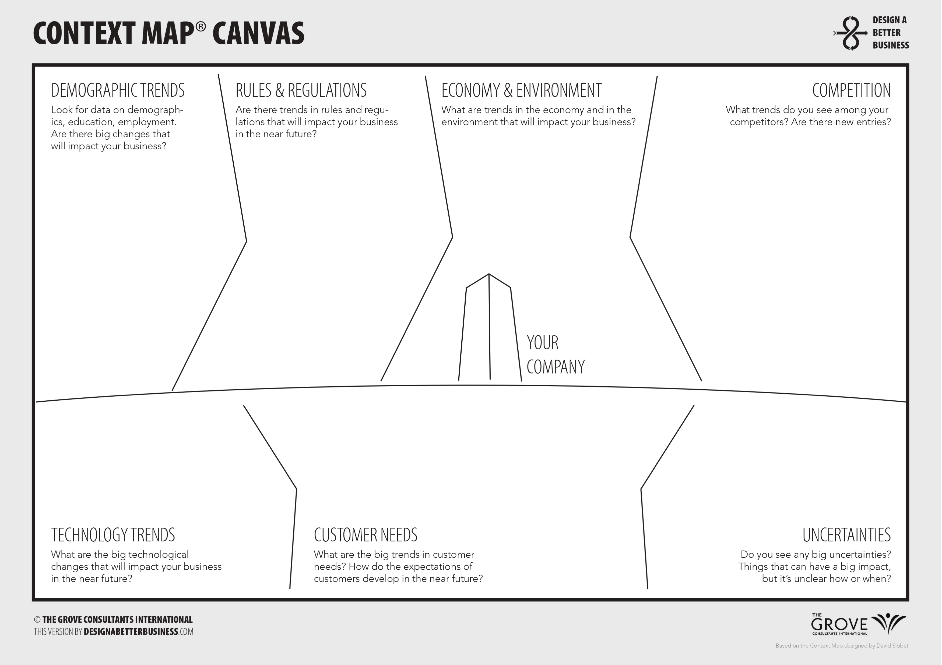
STAGE 1 - OPPORTUNITY IDENTIFICATION
Step 1: Context Map Canvas
Identify opportunities for sustainable logistics operations of your chosen company. Consider the following areas and identify the top 3 threats and opportunities. You can watch the Context Map Canvas video to gain a better understanding of the canvas presented below. Discuss and complete the Canvas with your group.
Here is the Context Map Canvas overview:
YOUR COMPANY: The company or organisation stands in the centre of the image.
DEMOGRAPHIC TRENDS: Look for data on demographics, education levels, and employment situations. What are the significant changes in these areas?
RULES & REGULATIONS: What policies, rules, and regulations do you think will be applied in the (near) future? What is the government up to? Any new taxes?
ECONOMY & ENVIRONMENT: What is happening in the economy? And what is happening in the broader environment? Are there economic trends that will impact the business? Do you think climate change will have an impact?
COMPETITION: What about the competition? Take the time to find the unexpected competition. Are there new entries? Competition coming from unexpected sources?
TECHNOLOGY TRENDS: What new technological trends do you see emerging that will impact the business?
CUSTOMER NEEDS: How will the customer's needs change in the future? Do you see new trends? Do you see any significant shifts in customer behaviour? Are there new trends going mainstream?
UNCERTAINTIES: Do you see any essential uncertainties? Things that potentially have a huge impact, but it is unclear how or when.
You can download the Context Map Canvas here. Select a digital tool to work on it, such as Miro, Edraw, Trello, ClickUp, Lucidchart, Simplemind, MindMeister, or Mindjet.
For instructions on how to use Miro, have a look at pages 9-10 of this document.
2
3
4
5
1
6
7
8

Slide 7
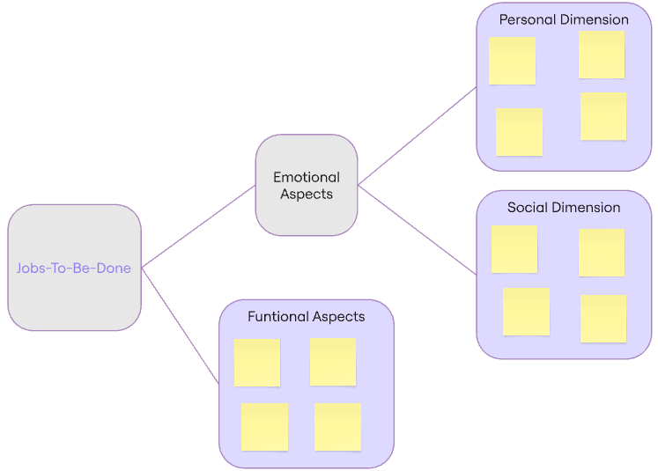
STAGE 1 - OPPORTUNITY IDENTIFICATION
Step 2: Jobs-to-be-Done Framework
The Job-to-be-Done (JTBD) framework is a customer-centred innovation method that transforms the
fundamentals of jobs-to-be-done thinking into an innovation practice. This framework enables companies to identify customer needs and deconstruct a job that customers are trying to get done into specific process steps. The resulting map provides a structure that makes it possible, for the first time, to capture all the customer’s needs and to systematically identify growth opportunities.
In this step, build upon your known opportunities (from Step 1) by employing the JTBD method. Watch the video Job-to-be-Done with examples on the theory to get familiar with the framework. After watching the video, imagine an ideal customer and identify the different jobs that can be fulfilled with products/services. Separate your findings into three subcomponents: functional job aspects, emotional job aspects (personal) and emotional job aspects (social).
“Job” is shorthand for WHAT an individual seeks to accomplish in a given circumstance. The circumstances are more important than customer characteristics, product attributes, new technologies, or trends. Jobs are never simply about function – they have powerful social and emotional dimensions. Good innovations solve problems that previously had only inadequate solutions, or no solutions at all.
You can capture insights with the JTBD template by separating your findings into three jobs:
1. Functional Aspects
They are goals that people strive to achieve, which can be measured by speed and accuracy. Functional jobs are independent of any solutions they might be using.
Example: Why do customers buy an iPhone? Calling and messaging people, having a pocket computer always by your side.
2. Emotional Aspects: Social Dimension
Focusing on how customers want to be perceived by others while executing a job.
Example: Why do customers buy an iPhone? Be seen as a tech-savvy person.
3. Emotional Aspects: Personal Dimension
How your customers want to feel and be perceived while executing the functional job.
Example: Why do customers buy an iPhone? Easy to use, connectivity with other Apple products.
You can use the template from Miro (click on ”Use template” and log in to start working), or you can select another relevant tool to perform this task, such as Edraw, Lucidchart, Simplemind, MindMeister, or Mindjet.
For instructions on how to use Miro, have a look at pages 9-10 of this document.

Slide 8
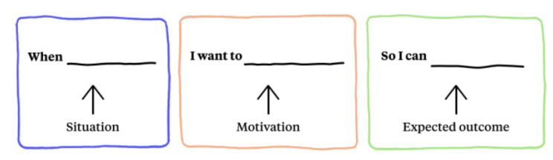
STAGE 1 - OPPORTUNITY IDENTIFICATION
Step 3: Applying Jobs-To-Be-Done
Build upon the jobs identified and transform them into user stories. Apply the JTBD theory by
creating user stories in the format below:
Examples:
"[When going to work] [I want to know all my transportation options] [so that I can stay flexible]"
"[When leaving the house in the morning] [I want to be informed about possible traffic jams] [so that I arrive on time]"
"[When I go groceries shopping] [I want to shop regional vegetables] [so that I support the locals and feel good about myself]“
You can select a relevant tool to perform this task, such as Miro, Edraw, Trello, ClickUp, Lucidchart, Simplemind, MindMeister, or Mindjet.
For instructions on how to use Miro, have a look at pages 9-10 of this document.

Slide 9
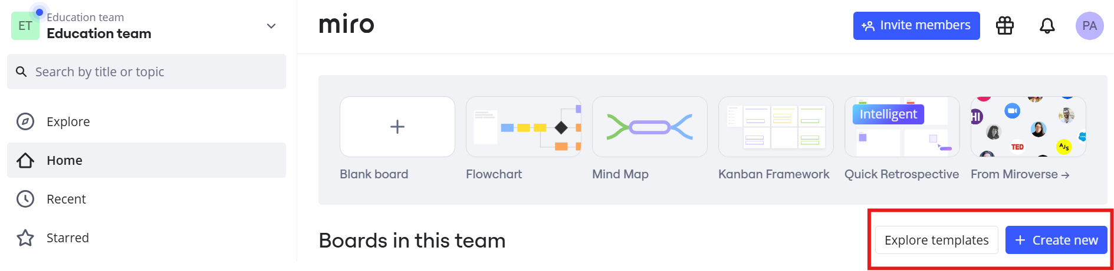

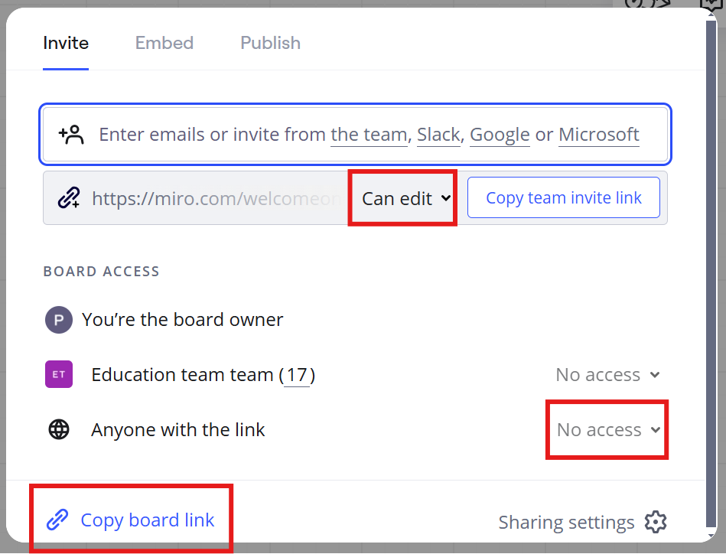

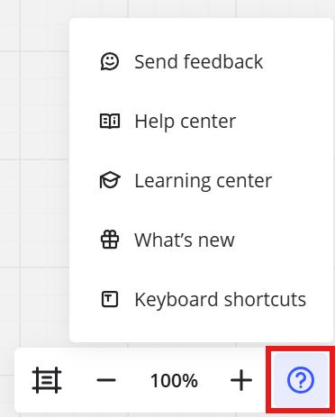
STAGE 1 - OPPORTUNITY IDENTIFICATION
Instructions: How to Use Miro
Go to the Miro webpage on your browser – www.miro.com.
Sign up or log in with your credentials.
To get started, click on "+ Create New“ and then on "Board“ or on "Explore templates“ (alternatively, you can click on a template link in the tasks above).
The menu at the top gives you options for naming the board, choosing an icon and some general settings for the board itself.
The menu on the top right side gives you options for collaboration, such as voting, commenting, reacting, watching/recording talk tracks and sharing the board. Now you can either invite people directly, or you can share the link for the entire board – you can edit permissions for the invitations by choosing an option from the dropdown menu.
In the bottom right, you can find a menu including tools for zooming in and out of the board as well as a button for help, including the help centre and further tips for using Miro.

Slide 10

STAGE 1 - OPPORTUNITY IDENTIFICATION
Instructions: How to Use Miro
7. The left sidebar includes the tools for editing and creating your board.
When this arrow is selected, you can use your mouse to move to your preferred position on the board via drag and drop.
This tool lets you explore templates.
This lets you drag and drop sticky notes in multiple colours onto the board on which you can write text or put a picture. With “View Templates”, you can view suggested sticky note combinations.
This gives you the option to add a text field onto the board.
This tool gives you the option of adding shapes such as circles or arrows onto the board for better visualisation.
With the Freehand Image tool, you can draw on the board with various pencil options.
This tool helps you determine the size of your board.
Additional tools can be found here – this includes embedding tables, mind maps or polls.
With these arrows, you can undo/redo an action.
In essence…
Miro is an excellent tool for collaboration, especially in the early stages of the innovation process, such as identifying opportunities. Its real-time collaboration feature allows teams to brainstorm ideas seamlessly, regardless of location. The infinite canvas offers the flexibility to visually map out insights, trends, and pain points, fostering creativity and structured ideation. With sticky notes, mind maps, and frameworks like SWOT or empathy maps, teams can efficiently capture and organise opportunities. Additionally, integrations with tools like Slack, Microsoft Teams, and Jira ensure that insights flow smoothly into later development stages, making Miro a powerful platform for innovation.
For further questions, visit the Miro Help Centre.

Slide 11
WEEK 9

Slide 12
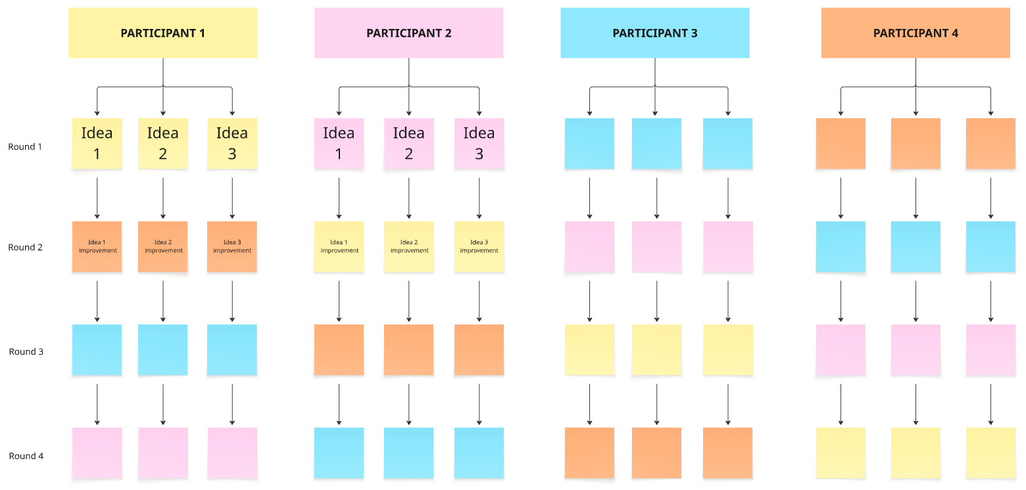
STAGE 2 – IDEATION AND IDEA MANAGEMENT
Step 1: Brainwriting Method
Brainstorm ideas through the Brainwriting method. This technique can alleviate two of the biggest brainstorming pitfalls – unbalanced conversation and the anchoring effect – by ensuring that everyone contributes and eliminating the bias toward the first idea.
Round 1 (10 minutes): Each group member writes down three ideas related to the topic of the brainstorming.
Round 2-3 (5 minutes per round): (as many rounds as needed to fit the number of students in the group.) Each person passes their ideas to another in the group, who will then build on them, adding bullet points as needed. After that, everyone will review the ideas again until all group participants have added bullet points to each one.
Round 4 (10 minutes): Once everyone has contributed to each of the ideas, discuss any unclear points and share what you like/dislike about each idea.
You can use the Miro Brainwriting template or Miro Mindmap template (click on ”Use template” and log in to start working), or you can select another relevant tool, such as Lucidspark, MindMeister, Bluescape or MindMup to create a brainwriting framework.
For instructions on how to use MindMeister, have a look at pages 14-15 of this document.

Slide 13
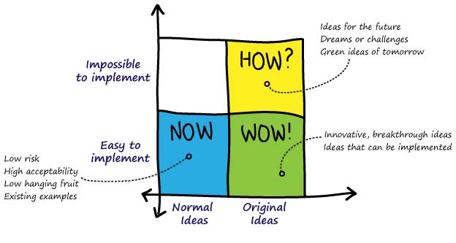
STAGE 2 – IDEATION AND IDEA MANAGEMENT
Step 2: How-Now-Wow Matrix
A How-Now-Wow matrix is an idea selection method used to uncover the best ideas. The matrix categorises ideas based on their level of newness (incremental or disruptive ideas) and ease of implementation (easy or difficult), and has four quadrants:
Yellow: How Ideas – Original ideas, impossible to implement. This quadrant represents ideas that are innovative but difficult to implement, so they are not yet feasible; however, they might be worth considering as future goals.
Blue: Now Ideas – Normal ideas, easy to implement. This quadrant represents unoriginal ideas that are familiar, easy to implement, and proven to work well. These ideas result in incremental outputs.
Green: Wow Ideas – Original ideas, easy to implement. This quadrant represents new ideas that are easy to implement within the current reality and executable ideas that can be actualised. Aim to form as many ideas in this category as you can.
How do you use a How-Now-Wow Matrix?
Phase 1: List all the ideas and opportunities.
Phase 2: Each group member gets 3 sticky dots of each colour (3 blue, 3 yellow, and 3 green).
Phase 3: Each group member is to vote for their top three ideas in each category. They will do this by placing a coloured dot on the post-its of the ideas they choose.
Phase 4: Once voting is complete, count the dots in each idea. The idea with the most dots of a particular colour is categorised under that colour. If there’s a tie, e.g., blue dots = green dots, the idea is categorised as blue. If yellow and green dots are tied, the idea is categorised as green.
Phase 5: You now have a set of "Wow" ideas (green) to work on further. Additionally, collect the blue ideas for quick implementation and the yellow ideas for future monitoring.
You can use the Miro How-Now-Wow Matrix (click on ”Use template” and log in to start working), or you can select another relevant tool, such as Lucidspark, MindMeister, Bluescape or MindMup to create a How-Now-Wow matrix (or other idea selection/prioritisation method).
For instructions on how to use MindMeister, have a look at pages 14-15 of this document.

Slide 14
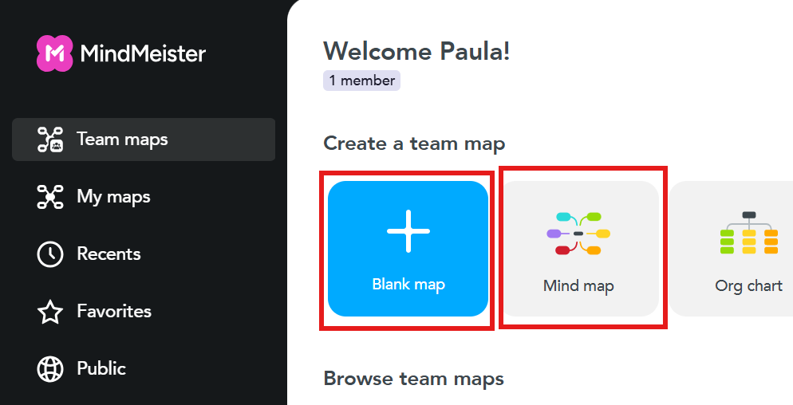

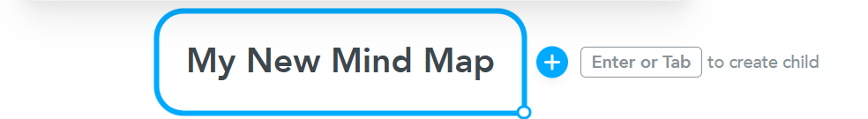
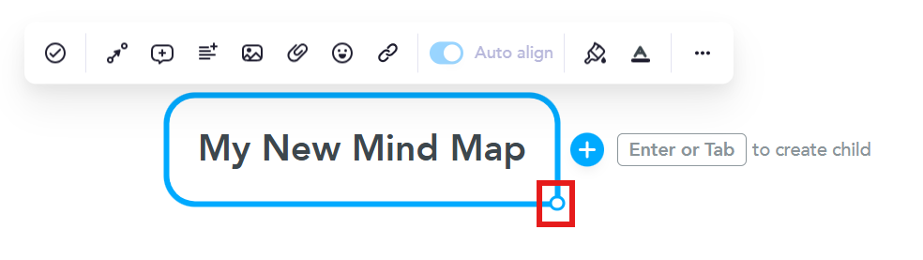
STAGE 2 – IDEATION AND IDEA MANAGEMENT
Instructions – How To Use MindMeister
Go to the MindMeister website on your browser (http://www.mindmeister.com/) and create an account or log in.
Create a new map by either selecting “Blank map” or a template such as “Mind map” on the home page.
A mind map element will look like this – if you click on the text/the middle of it, you can write, edit and collect topics for the mind map.
If you click on the bottom right circle, you will get to a menu:
Here, you can link tasks to elements – assign duties and due dates to certain team members.
Here, you can connect two elements to each other.
Add a comment to an element.
Add a note to an element.
Add media, such as videos or images, to an element.
Add an attachment to an element.
Add an icon/emoji to an element.
Add a link to an element.

Slide 15
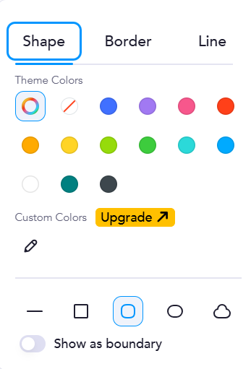

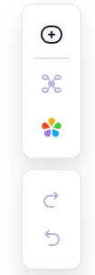

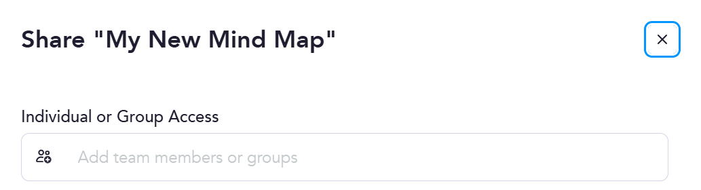
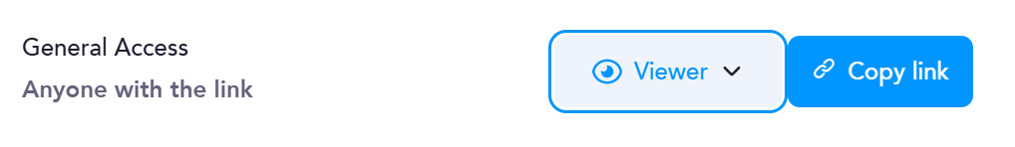
STAGE 2 – IDEATION AND IDEA MANAGEMENT
Instructions – How To Use MindMeister
(Continuation of the menu bar from the previous page)
Auto-align the elements of your mind map
Change the style of your element – choose different shapes, borders and lines
Change the text style of the element
Add a new child element to the topic
5. On the right side, you have the following menu options:
Add a new floating topic
Change the layout of your elements
Change the theme of your mind map
Undo
Redo
6. To add collaborators to your mind map, click on “Share” in the top right corner.
Add registered MindMeister members via mail or username
Or: Share a link with the desired role setting
For further questions, visit the MindMeister Help Centre.

Slide 16
WEEK 10

Slide 17
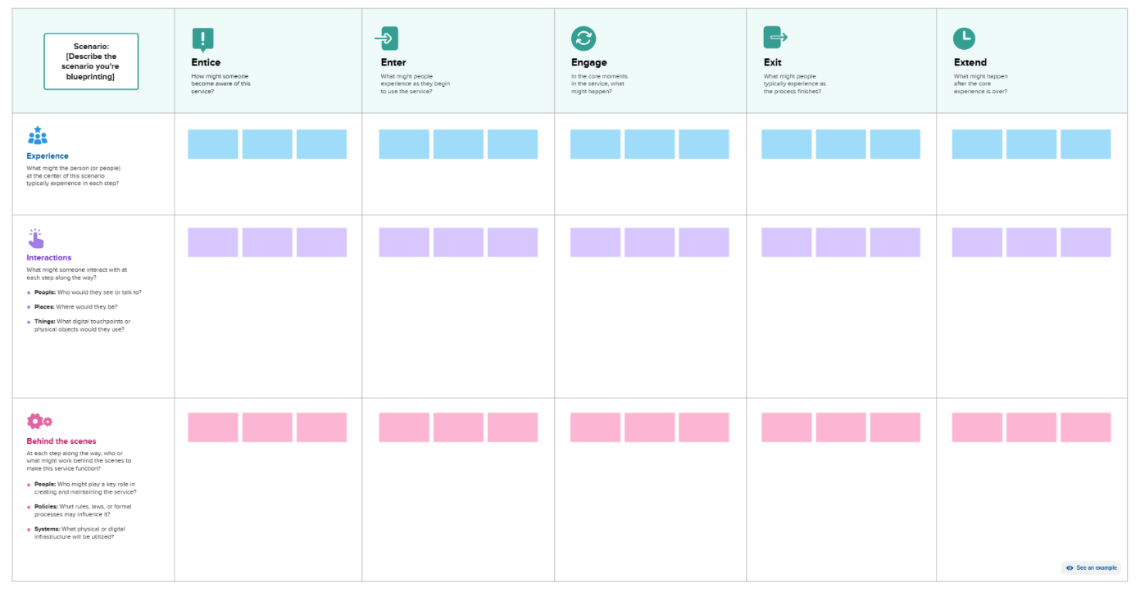
STAGE 3 – CONCEPT DEVELOPMENT
Once an innovative idea has been evaluated and selected in Stage 2, the concept of
the service or process needs to be defined.
According to Dornberger & Suvelza (2012), the definition of concept must specifically
answer the questions below:
Step 1: Generating a Concept
The Service Blueprinting tool helps generate concepts of potential innovative services. A Service Blueprint is a visual representation that maps out the connections between various service elements – such as people, tools (both physical and digital), and processes – that interact at key touchpoints throughout a customer journey (Gibbons, 2017). The following dimensions can describe Service Blueprinting for new services:
Experience: Understand what customers experience at each stage of their journey, focusing on emotions, actions, and perceptions.
Interactions: Identify the people, places, and things with which customers interact throughout the service experience, both directly and indirectly.
Behind the Scenes: Recognise the internal processes and employee actions that support each stage of the customer experience, though not visible to the customer.
Entice: Guide customers to become aware of your service through targeted marketing, promotions, or word-of-mouth.
Enter: Encourage customers to explore your service offerings, whether by navigating a website or entering a physical space.
Engage: Ensure customers actively use the service, interacting with available tools, platforms, or representatives.
Exit: Support customers as they complete their service experience, providing options for feedback or final actions.
Extend: Foster ongoing engagement by prompting customers to return, refer others, or participate in follow-up activities.
What is the process or service?
What need or desire must the process or service meet?
Who is the target of the process or service?
How is the process or service different from the competitors?
How is the process or service generated?
What are the parts or components of a process or service?

Slide 18
STAGE 3 – CONCEPT DEVELOPMENT
How to create a Service Blueprint Diagram
1: Identify the process to be blueprinted
You need to determine the concept of service processes. First, identify all the key activities involved in creating and delivering the service process. Think about the questions: What is the service? and What need or desire must the service meet?
2: Identify the customer or customer segment
Identifying customer segments involves dividing customers into distinct groups that share similar traits (e.g., personality, interests, habits) and/or characteristics (e.g., demographics, industry, income).
Now you need to determine your customer (segment). You need to answer: Who is the target of the product or service? Keep in mind that customers can also be internal to the company, such as logistics employees.
3: Map the process from the customer’s point of view
You need to determine the steps, choices, activities, and/or interactions that the customers perform while interacting with a service to reach a particular goal.
Think of the process as a sequence of actions the customer takes, from the first point of contact to the completion of their goal. For example, if the goal is to make a purchase, map out everything the customer does, from browsing to checkout.
4: Map the contact employee actions on the frontstage and backstage
Frontstage actions refer to the visible interactions of contact employees and encompass the actions that occur in the customer's presence. Backstage actions refer to invisible contact with employees’ actions, including non-visible interactions with the customer, such as telephone calls and other activities that employees carry out backstage to support the frontstage activities.
Now, in the template provided, map the actions: What do frontline contact employees do when they encounter customers face-to-face (under “Interactions”)? After this step, continue to map the “Behind the scenes” actions.
You can use the Mural Service Blueprint template (click on ”Start from this template” and log in to start working), or the Miro Service Blueprinting template (click on ”Use template” and log in to start working), or you can select another relevant tool, such as Canva, Sketch, Bluescape, or Lucidspark to create a service blueprinting diagram.
For instructions on how to use Canva, have a look at page 20 of this document.

Slide 19
STAGE 3 – CONCEPT DEVELOPMENT
Step 2: Describing Concepts – Value Proposition
The value proposition is defined as “a clear, simple statement of the benefits, both tangible and intangible,
that the company will provide, along with the approximate price it will charge each customer segment for those benefits” (Lanning and Michaels, 1988).
You can use the following templates to formulate the value proposition for your concept (Gronsund, 2011):
You can select a relevant tool, such as Canva, Sketch, Bluescape, or Lucidspark, to create a service blueprinting diagram.
For instructions on how to use Canva, have a look at page 20 of this document.
Geoff Moore’s Value Propositioning Statement
For (target customer) who (statement of the need or opportunity) our (product/service/process name) is (product /service/process category/description) that (statement of benefit).
Example:
For non-technical marketers who struggle to find the return on investment in social media, our product is a web-based analytics software that translates engagement metrics into actionable revenue metrics.
Simon Sinek’s WHY
Why: _________ How: _________ What: _________
Example:
Why: In everything we do, we believe in challenging the status quo. We believe in thinking differently.
How: The way we challenge the status quo is by making our products beautifully designed, simple to use, and user-friendly.
What: We just happen to make computers.
Clay Christensen’s Jobs-to-be-done
Action verb: ______________ Object of action: _____________ Context identifier: _____________.
Examples:
“Manage personal finances at home.” (Mint.com)
“Preserving fun memories.” (Kodak’s Funsaver)
“Listen to music while jogging.” (iPod)

Slide 20
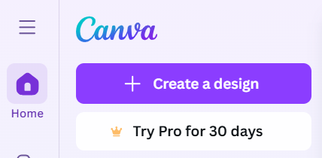
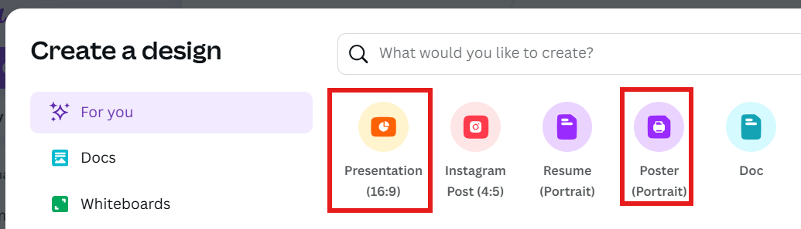


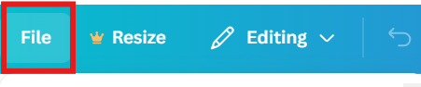

STAGE 3 – CONCEPT DEVELOPMENT
Instructions - How To Use Canva
Log in or sign up on Canva.
To start a new project, click “+ Create a design” on the top left corner of the home page.
Decide on a format for your project, e.g. presentation or poster and select it either from the suggestions or the bar on the left.
Once you have started the project, these are the selectable tools on the left side:
By clicking on “File” at the top left, you get several options for the project document itself, including download, settings and location of the file.
The menu on the top right gives you more important tools (from left to right):
See analytics for the project.
View comments on the document.
Present the presentation in different modes.
Share the project – here, you can invite collaborators with the desired permissions or download.
For more questions, visit the Canva Help Centre.
Change the template, layout or style of your project.
Add elements such as graphics or shapes to your project (look for things via the search bar).
Add a text box.
Use branded elements (paid version).
Upload files that you want to add to your project.
Draw, add shapes or sticky notes, texts or tables.
Switch to a different project on your Canva account.
Connect Canva to different apps to include graphs, music or translation.
Add images, graphics or videos generated by AI.
Change the background of your project.
Include a chart.

Slide 21
WEEK 11

Slide 22
STAGE 4 – SERVICE DEVELOPMENT
As the fourth process step, the (Service) Development phase takes place. Explicitly
process steps that are relevant to (service) innovation have been established, which are
the implementation of changes after having tested the concept, experimentation and/or
simulation of the implemented ideas, the development of different service/product elements, as well as the preparation for validation of the innovation. In this stage, implementation and integration activities such as software development would be a focus, design activities, many rounds of prototyping and developing a pilot service. Validation activities are prepared for the next stage, such as planning usability tests.
(Digital) Prototyping forms an important element in the step. A digital prototype is a mockup of a product/service/process that gives you, your stakeholders and users an initial idea of how the software will look or work. Most importantly, it is a first step towards releasing to market a product or feature that fulfils users’ needs and your goals. It allows testing (with users, stakeholders, and investors) the general concept for the design. A prototype has no engineering behind it, with few or no working functionalities or real data. The prototype is often a front, an interactive visualisation or clickable trailer of the product/service/process – a means to test and validate the look and feel decided on so far and the main concept.
Under normal circumstances, a digital prototype usually takes between 1 and 2 weeks to build and answers several business needs, including testing and data gathering, ideating and visualising. As part of this course, however, we are going to engage in a form of pressurised rapid prototyping.
Step 1: MoSCoW Method
Reflect on the text and information given and design a service blueprinting flowchart for the company’s new service, product or process. For that, you need to answer: What are the core elements of your new product/service/process?
The acronym MoSCoW represents four categories of initiatives: must-have, should-have, could-have, and won’t-have or will not have right now. Some companies also use the “W” in MoSCoW to mean “wish”.
You can use the Miro MoSCoW Matrix template (click on ”Use template” and log in to start working), or you can select another relevant tool, such as Sketch, Milanote, or Lucidchart, to create a MoSCoW diagram.​
For instructions on how to use Milanote, have a look at page 25 of this document.
M = MUST HAVE:
non-negotiable product/service needs that are mandatory for the product to function
S = SHOULD HAVE:
important aspects that are not vital but add significant value to your product
C = COULD HAVE:
nice to have aspects that will have a small impact if left out
W = WILL NOT HAVE
BUT WISH TO HAVE:
aspects that are not a priority for this specific time frame (but might be added later)

Slide 23
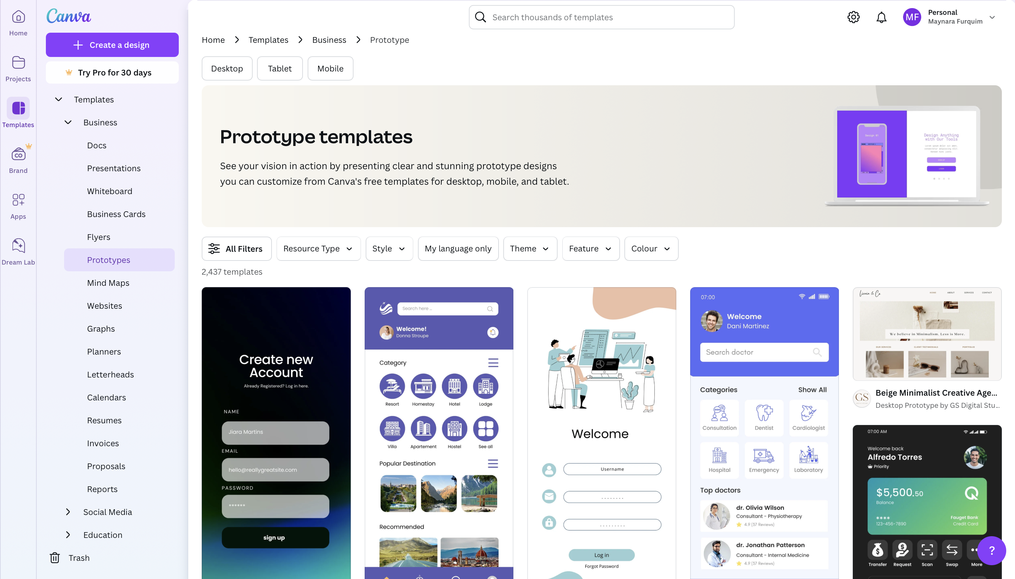
STAGE 4 – SERVICE DEVELOPMENT
Step 2: Prototype Design
Visit the following page on Canva: Free and customisable prototype templates.
Take a couple of minutes to explore some of the templates.
In your team, discuss how such templates might help you in designing your own prototype for your sustainable logistic solution (service, or process).
Choose up to 3 templates and design different versions of your prototype – work on it until your group has a testable version for the next stage (focus on bringing your ideas to life visually, even if it is not perfect).
Keep all your prototype versions for project documentation, and later present them to the other teams and discuss your process.

Slide 24
STAGE 4 – SERVICE DEVELOPMENT
Step 3: Curveball Scenarios
In the innovation management process, unexpected challenges – often referred to as curveball scenarios – can emerge at any stage, from idea generation to implementation. These scenarios represent unforeseen events or disruptions that can threaten the success, scalability, or sustainability of an innovation. Whether it is a sudden shift in market demand, regulatory changes, supply chain disruptions, or user resistance, effective innovation management requires teams to anticipate and respond to these risks with agility and creativity. Exploring curveball scenarios helps teams build resilience and develop proactive strategies to safeguard their solution in real-world contexts.
Choose one of the curveball scenarios below and consider the challenges and opportunities it introduces. Use the guiding questions to explore its implications and rethink your prototype from Step 2. Focus on reinforcing your solution’s core strengths, increasing its adaptability, and addressing any vulnerabilities that emerge. Identify strategies to manage or mitigate the associated risks. If time allows, feel free to explore additional scenarios for a broader perspective.
Cybersecurity Breach: A data leak or ransomware attack disrupts digital logistics operations.
  What types of data are most vulnerable in your solution, and how can they be protected?
  How would a cybersecurity incident impact trust and operations, and how can you respond quickly?
Supply Chain Breakdown: Critical components or spare parts become unavailable due to geopolitical tensions or natural disasters.
  Which parts of your solution rely on external suppliers or global components?
  What alternatives or redesigns could reduce dependency on vulnerable supply chains?
User Rejection: Customers or partners resist adopting the innovation due to complexity, trust issues, or cultural barriers.
  What might make your solution difficult to adopt or trust from the user’s point of view?
  How could you simplify or reposition your solution to increase acceptance?
Power Failure: A blackout disables critical systems at key hubs with no immediate backup.
  Which parts of your system would be disrupted by a power outage?
  What backup systems or manual alternatives could you introduce?
Extreme Weather: Flooding, heatwaves, or storms damage infrastructure or delay operations.
  How exposed is your innovation to weather-related disruptions?
  What design or process changes could improve climate resilience?
Connectivity Loss: A mobile network or satellite outage cuts off tracking and communication tools.
  What happens if your digital features stop working temporarily?
  How can your solution still function or provide value without connectivity?
Labour Strike: Workers protest the innovation, citing job insecurity or safety concerns.
  How might workers perceive your innovation—as a threat or a benefit?
  What steps could you take to engage staff and co-create the solution?
Customer Misuse: End users exploit or damage the system in unforeseen ways, resulting in increased service calls and downtime.
  In what ways could users misuse your solution, intentionally or not?
  What features or support systems could prevent or manage this misuse?

Slide 25
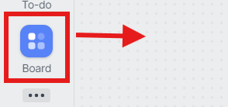

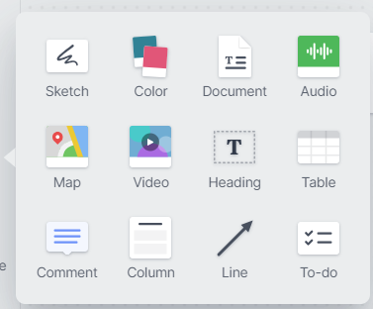

STAGE 4 – SERVICE DEVELOPMENT
Instructions – How To Use Milanote
Log in or sign up to Milanote.
To create a new board, click on “Board” on the sidebar and drag it onto the empty space. Once it is on the big space, you have the option to name the board.
Double-click on the board to open it – the sidebar gives you several options to create the content of your board. These options also work with a drag-and-drop principle.
On the top right, you can share the board with collaborators, export your project to pdf or png and change the zoom.
For additional help, visit the Milanote Help Centre.
A note gives you the option to add text to your board.
Add a link to your board.
Add a new sub-board (open with double-click).
Advanced options to add to your board.
Add an image to your board.
Upload a file or image to add to your board.
Draw on your board.
Delete certain elements from the board.

Slide 26
WEEK 12

Slide 27
STAGE 5 – TESTING AND VALIDATING PILOT SERVICE
Step 1: Usability Test Design
Design a small-scale usability test (in class) to demonstrate that the sustainable logistics solution is functional and can be effectively implemented in a real-life scenario. Answer the following questions for it:
Problems you want to focus on:
What is the purpose of the test?
What tasks can help you to ﬁnd these answers?
Questions you want to ask:
What specific questions do you want to ask users about the solution?
What are you trying to ﬁnd out?
If the testing were to take place in real life:
What type of users should participate in the test? Go beyond demographics and consider interests, the connection they have to the company, and their habits.
How can you recruit participants based on the group deﬁned above?
What tools would you use to conduct this usability test?
How would you collect and analyse the feedback?
Step 2: Online Survey
The usability test you have designed above should take place online to create an online survey.
Use a digital tool to develop a short survey that helps you find the answers to the questions you defined in Step 1. Keep in mind the following tips:
Questions must be easy to understand and answer.
Group the questions by topic.
Place sensitive questions at the end.
You can use Google Forms (for instructions on how to use it, have a look at pages 28-29 of this document), or you can select another relevant tool, such as Qualtrics, Microsoft Forms, or any other preferred platform to create your testing survey.
Step 3: Analyse the Data Collected
Once your survey has collected sufficient responses, gather and organise the data for analysis. Focus on identifying key insights and the areas for improvement of your sustainable logistics solution.
Visualise the results to make them easy to interpret, for example, using charts, graphs, or infographics. Choose a format that clearly communicates the most important findings to your team.
You can use tools like Google Forms, Qualtrics, Microsoft Forms, or any other survey platform you prefer, many of which include built-in visualisation features. Alternatively, you can export the data to Excel, Google Sheets, or a data visualisation tool (such as Canva, Tableau, or Flourish) for more customised visuals.

Slide 28
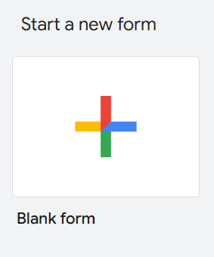
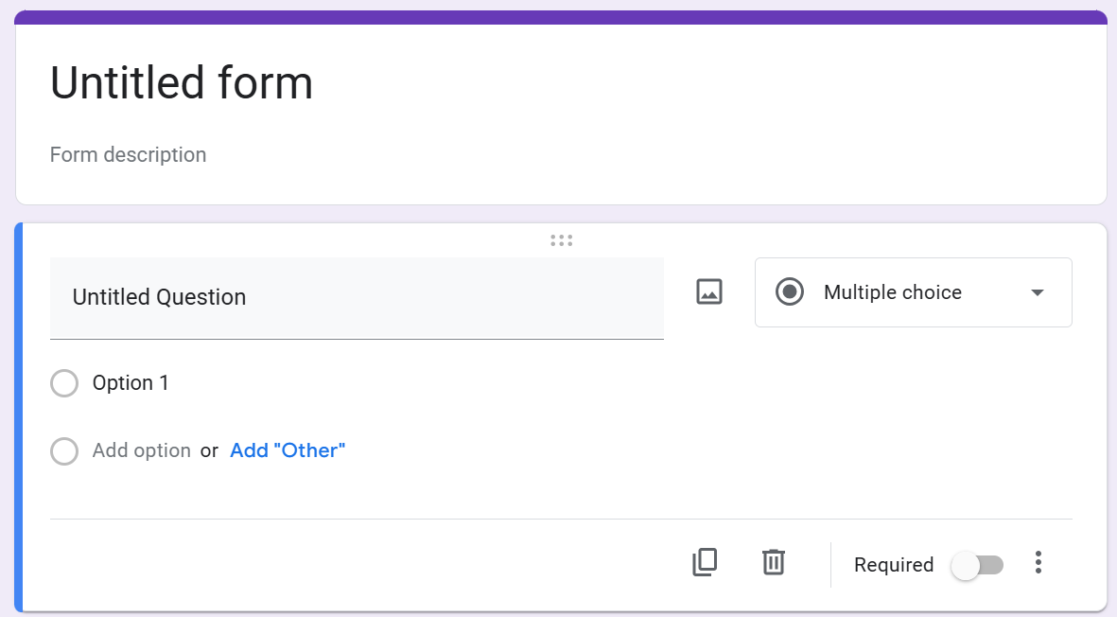


STAGE 5 – TESTING AND VALIDATING PILOT SERVICE
Instructions – How To Use Google Forms
Open Google Forms and sign up/log in.
Create a new questionnaire by clicking “+” or select a template.
Now you can name your form, give it a description and add/edit questions. For questions, you can choose between Multiple choice, written answer, check box, or many more – choose whatever suits your purposes best.
The menu on the top right gives you multiple options for your form:
Once you have sent out the questionnaire and people have answered it, you can view the answers here.
Here you can publish your form – either to anyone with a link or you can invite specific Google accounts
Here you can add team members to collaborate with on your Google Form
Here you can copy the link to your form to invite collaborators
Redo
Undo
See a preview of your form
Change the appearance of your form

Slide 29

STAGE 5 – TESTING AND VALIDATING PILOT SERVICE
Instructions – How To Use Google Forms
In the settings section, you can edit, for example, how responses are collected or presented and set form or question defaults.
For additional help, visit the Google Workspace Learning Centre.
Examples for Questions
Here are some examples of which types of question and answers you can collect with your online form. Please be mindful of the questions' applicability to your scenario and solution.
General Usability & Experience
How easy was it to use the solution? (Scale: 1 - Very Difficult to 5 - Very Easy)
Were there any features that felt confusing or unnecessary? (Open-ended)
How intuitive was the navigation within the solution? (Scale: 1 - Not Intuitive to 5 - Very Intuitive)
Effectiveness & Functionality
Did the solution effectively address the logistics challenge it was designed for? (Yes/No, with an option to explain)
What features of the solution worked well? (Multiple choice: speed, ease of use, design, sustainability impact, etc.)
Were there any technical issues or bugs? (Yes/No, with an option to describe the issue)
Sustainability & Impact
How well does this solution align with sustainability goals? (Scale: 1 - Not at all to 5 - Fully aligned with SDGs)
Do you think this solution could contribute to more sustainable logistics operations? (Yes/No, with an option to explain)
User Feedback & Suggestions
What improvements would you suggest for this solution? (Open-ended)
Would you recommend this solution to others in the logistics operations? (Yes/No, with an option to explain why or why not)

Slide 30
WEEK 13

Slide 31
STAGE 6 - LAUNCH
Step 1: Your Commercialisation/Implementation Plan
Before launching your sustainable solution, consider the following:
Target Market & Stakeholders
  Who will use this solution (e.g., logistics companies, suppliers, retailers, customers)?
  What type of locations (e.g. rural villages, temporary events, post-disaster zones) are most suited for initial deployment?
  Which stakeholders (e.g. external partners, local authorities, communities) need to be involved in the implementation (e.g. planning, permissions, outreach)?
2. Implementation Strategy
  How will the solution be integrated into existing logistics operations?
  What resources (e.g., technology, personnel, funding) are needed?
3. Sustainability & SDG Alignment
  How does your solution contribute to specific SDGs?
  What measurable sustainability benefits does it offer?
4. Timeline & Key Milestones
  What are the critical steps in launching the solution?
  What is the estimated timeframe for each phase?
  What data should be collected to evaluate the impact, cost efficiency and customer satisfaction of the piloting?
5. Risk Assessment & Mitigation Strategies
  What potential risks could arise (e.g., technical, financial, regulatory)?
  How will you address these risks?
  Fill in the table below for your project:
Aspect | Details
Solution Name
Target Market & Stakeholders
Implementation Strategy
SDGs Alignment
Key Milestones
Risks & Mitigation

Slide 32
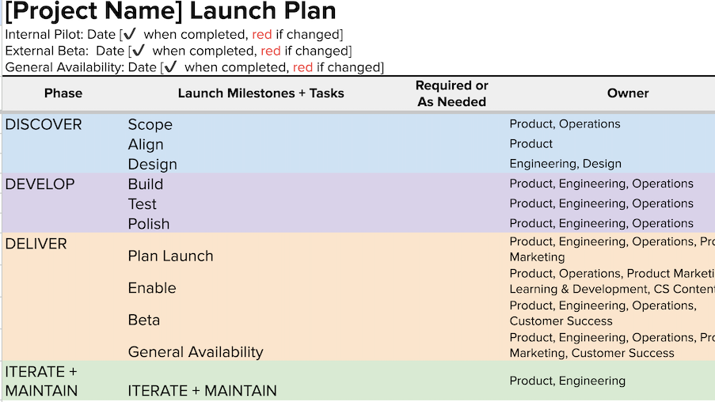
STAGE 6 - LAUNCH
Step 2: Launch Plan Development
Select a relevant digital tool, such as Trello, Planbox, Planview Split, ClickUp, Asana, Monday.com or edison365 to structure your launch plan.
For instructions on how to use Trello, have a look at pages 33-34 of this document. ​
Follow these steps in your selected tool:
Set up a workspace for your action plan.
Break down the launch into phases: Identify key phases, such as Preparation, Testing, Rollout, and Follow-up (note: these phases are suggestions; feel free to create your own). Ensure that the phases align with the key implementation elements discussed in Step 1 (e.g., target market, stakeholders, resources, and risks).
Define Tasks: List specific tasks under each phase. Consider the tasks outlined in Step 1 and translate them into actionable steps for each phase. These tasks could include things like identifying stakeholders, securing resources, testing the solution in pilot locations, engaging with partners or authorities, etc.
Assign responsibilities to team members.
Set timelines and key milestones: Add fictional but realistic durations and responsible teams for each task based on the information gathered in Step 1. Include key milestones (e.g., “pilot completed”, “launch day”) that reflect the major steps in both your commercialisation and implementation strategy. Ensure the chart allows for flexibility in how durations and team responsibilities are allocated, enabling teams to adapt the plan to real-world conditions as necessary.
Add tracking elements (e.g., progress indicators, risk management).
Here is an example of how a Launch Plan could look like:
Prepare a brief summary of your launch plan using your selected tool.
Show how the digital tool supports the commercialisation process.
Ensure alignment with sustainability priorities and the SDGs.
Reflection Questions
How does your plan ensure a smooth implementation of the solution?
What challenges might arise during commercialisation?
How does the digital tool improve your planning and execution?

Slide 33
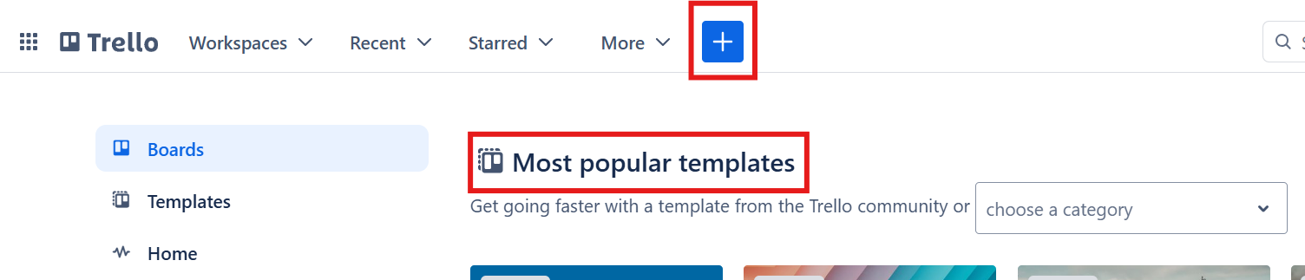
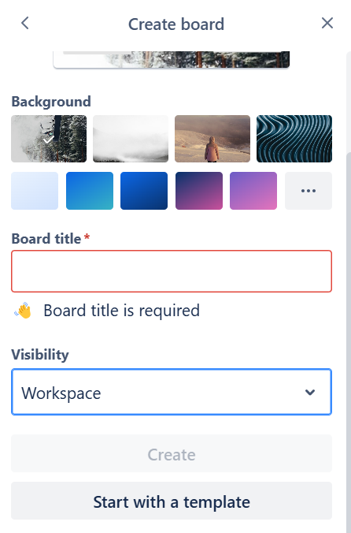

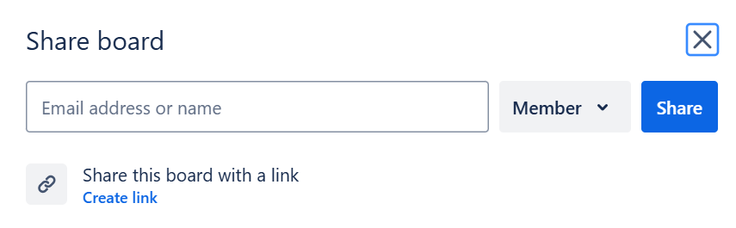
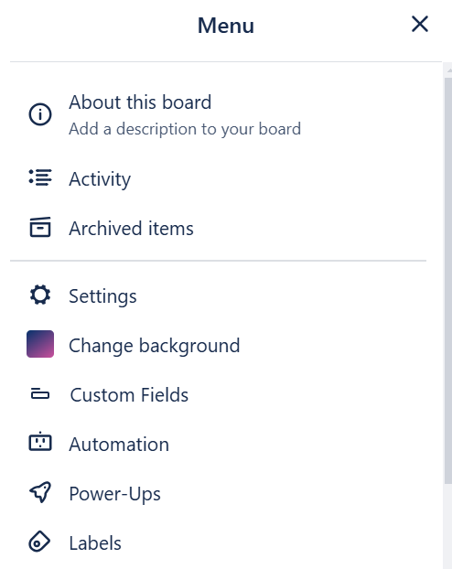
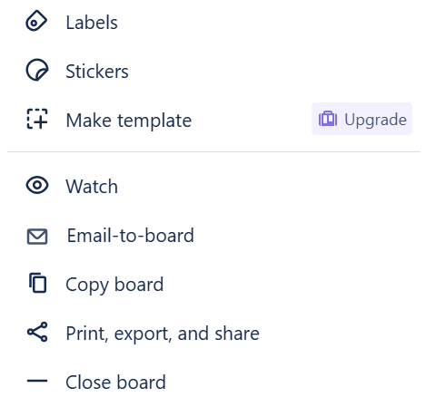
STAGE 6 - LAUNCH
Instructions – How To Use Trello
Go to Trello and sign up/log in
To get started with a new board, click on “+” in the top menu or choose one of the templates on the home page.
Customise your board with a background, title and visibility setting (controlling who can see and edit a board).
On the top right, you can find the option to share the board with team members and to open a broad selection of settings.
To share, type in the E-mail address or name of the team member on Trello and keep the visibility setting on “Member”.
The menu gives you the following options:

Slide 34
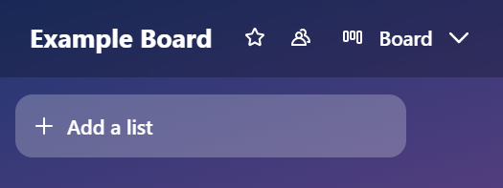
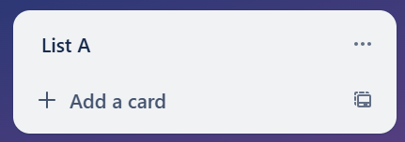
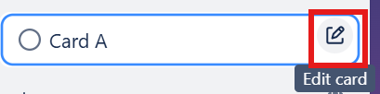
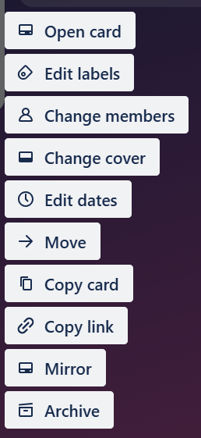
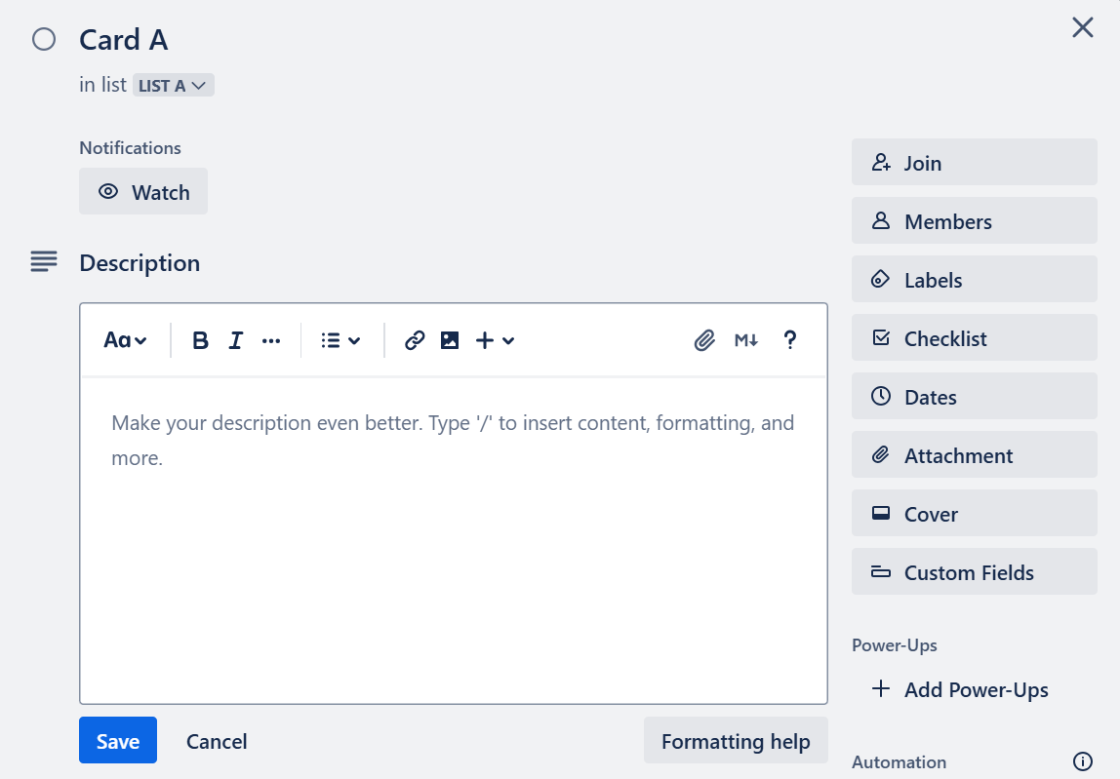
STAGE 6 - LAUNCH
Instructions – How To Use Trello
The menu on the top left gives you the option to rename the board (by clicking on its title), start a board (to add it to your favourites) or view and edit the visibility of the board.
Click “Add a lit” to fill your board.
After naming your list, you can add cards to your list by clicking “Add a card”. By clicking the three dots on the right, you can edit, move, and copy a list.
After adding and naming a card, you can hover over it and click on the button on the right to edit it.
Editing the card gives you the following options:
Click “Open Card” to see details:
Here, you can make changes such as assigning a card to a team member, setting a due date for the card, adding comments/attachments/labels and editing the visual aspects of the card.
Don‘t forget to save your changes!
For additional help, visit the Trello Guide.

Slide 35
WEEK 14

Slide 36
FINAL PRESENTATIONS AND DISCUSSIONS
This worksheet guides you in:
Structuring a consulting-style pitch for your final presentation.
Highlighting how your solution relates to sustainable logistics and the SDGs.
Clearly presenting your innovation management process and digital tools.
Providing constructive peer feedback using a structured evaluation template.
Before Class: Structuring Your Consulting-Type Presentation
Your presentation (10-15 minutes) should be clear, persuasive, and solution-driven, as if you were consulting for a real company. Follow this structure:
1. Introduction (1-2 minutes)
Briefly introduce your company and its logistics challenge.
State the relevant SDGs linked to the problem.
Outline your proposed solution in one sentence.
2. Innovation Management Process (6-9 minutes)
Explain how your team applied the six-stage innovation management process. You can use the following table to assist you with this:
Stage | Key Actions Taken | Digital Tools Used | Sustainability Impact
Opportunity Identification
Ideation & Idea Management
Concept Development
Service/Product/Process Development
Testing & Validating
Launch
3. Solution Impact & Key Takeaways (2-3 minutes)
Summarise the benefits of your solution for sustainable logistics.
Address potential challenges and how they could be mitigated.
Provide next steps for implementation in a real-world setting.
4. Conclusion & Call to Action (1 minute)
Reinforce why your solution is innovative, sustainable, and feasible.
End with a clear recommendation for the company’s next steps.

Slide 37
FINAL PRESENTATIONS AND DISCUSSIONS
In Class: Providing Peer Feedback
Each group will evaluate two other presentations using the template below.
Criteria | Excellent (5) | Good (4) | Satisfactory (3) | Needs Improvement (2) | Not Satisfactory (1)
Clarity & Structure | Well-structured, logical flow | Mostly clear, minor gaps | Some points unclear | Lacks organisation | Disorganised, difficult to follow
Innovative & Sustainable Approach | Highly creative, strong sustainability impact | Somehwat innovative, sustainability integrated | Moderate innovation, sustainability considered | Lacks innovation or susatinability focus | No innovation or sustainability focus, lacks originality
Use of Digital Tools | Tools well-integrated, clearly support process | Tools used effectively, minor gaps | Tools included but not well applied | Tools missing or unclear relevance | No relevant digital tools used
Engagement & Delivery | Confident, engaging, clear visuals | Mostly confident, good visuals | Some engagement issues, basic visuals | Lacks engagement, unclear visuals | Not engaging, difficult to understand, poor visuals
Overall | Outstanding presentation with strong impact, well-executed in all areas | Strong performance with minor weaknesses | Competent but with notable gaps in execution | Weak execution, missing key elements | Minimal effort, lacks key components, does not meet expectations
Group 1 | Points (1-5) | Comments
Clarity & Structure
Innovative & Sustainable Approach
Use of Digital Tools
Engagement & Delivery
Overall
Group 2 | Points (1-5) | Comments
Clarity & Structure
Innovative & Sustainable Approach
Use of Digital Tools
Engagement & Delivery
Overall
After scoring, provide one strength and one suggestion for improvement in the comment box for as many criteria as possible.
Submission & Discussion
Submit your peer feedback forms to the teacher.
Be prepared to discuss key insights and best practices from the presentations.

Slide 38
WEEK 15

Slide 39
REFLECTIONS AND LEARNING CONCLUSION
BEFORE CLASS
Before the last class, submit a reflection on the module in a reflective blog format.
This worksheet will guide you in writing a structured reflective blog on:
The digitalisation of innovation management practices.
Its impact on sustainable logistics and the SDGs.
Lessons learned throughout the module.
Your reflection should be analytical and personal, demonstrating how your understanding has evolved. These blogs will then be discussed in class to reflect on lessons learned.
Step 1: Structuring Your Reflective Blog
1. Introduction (150-200 words)
Briefly introduce the key themes of your reflection (digitalisation, innovation management, and sustainability).
State your initial perspective before starting the module.
Mention one key question or challenge you explored.
2. Main Reflection (500-600 words)
Reflect on the following questions:
  A. Digitalisation in Innovation Management
  How have digital tools influenced each stage of the innovation management process?
  Which digital tools did you find most effective? Why?
  Did digitalisation create any challenges or limitations?
  B. Sustainable Logistics and the SDGs
  How does digitalisation contribute to sustainable logistics?
  Which SDGs were most relevant to your case study?
  How could companies balance innovation, digital transformation, and sustainability goals?
  C. Lessons Learned & Personal Growth
  What was your biggest takeaway from the module?
  How has your understanding of innovation management changed?
  What skills or knowledge will you apply in the future?
3. Conclusion (150-200 words)
Summarise your main insights.
Provide one recommendation for improving digital innovation management in logistics.
Reflect on how this module influenced your career or academic interests.

Slide 40
REFLECTIONS AND LEARNING CONCLUSION
Step 2: Blog Formatting & Submission
Write in a blog-style format – meaning engaging, clear, and reflective.
Use headings and subheadings to structure your reflection.
Include examples from the module (case studies, tools, or discussions).
Your reflective blog is an opportunity to critically assess what you have learned and how it applies to real-world logistics challenges. Be thoughtful, specific, and analytical in your reflection.
How to submit your reflective blog:
Access the online form (link provided by your teacher).
Upload your blog text, structured as indicated in Step 1.
Submit your reflection before the final class, as defined by your teacher.
Step 3: Discussion in Class
During your final class, you will engage in a discussion to share key insights from your reflective blog, emphasising how your perspectives on the digitalisation of innovation management practices, sustainable logistics, and the SDGs evolved throughout the module.
Be prepared to discuss, specifically:
How digital tools support different stages of the innovation management process, and which tools were most effective.
How this links to sustainable logistics and the SDGs, how it enhances sustainability, and which SDGs were addressed.
How companies balance innovation and sustainability goals.​
How teamwork and project development went.
How you plan to apply the skills and knowledge you gained in the future.​
Step 4: Final Feedback
​
After completing the module, you will reply to a short quantitative evaluation questionnaire to assess what you have learned throughout your real-life challenge.​
​
Access the online form (link provided by your teacher).​
Answer the questionnaire.​
Submit your answers before the deadline defined by your teacher.

